Slide 1










CA 2E & CA Plex 2023
New and Updated Features

Slide 2
Welcome
We are glad to be here to present to you the latest updates in Plex and 2E.

Slide 3



Speakers
Mark
Schroeder
Kiyoshi Terasawa
Borys
Vulgarin

Slide 4






Highlight
CA 2E

Slide 5
New Features in CA 2E 8.7+
CA 2E 8.7.3
CA 2E 8.7.2
CA 2E 8.7.1
Notes:
Currently, the lookup in arrays within CA 2E RP4 based functions is done using the LOOKUP opcode. However, the performance of this opcode is slow. IBM has come up with the %LOOKUP built-in function which is more efficient and
faster compared to the LOOKUP opcode due to the following two critical aspects underlying %LOOKUPxx:
• A faster binary search
• Limiting the number of array elements to search for, as specified by its fourth parameter, as against an older LOOKUP
opcode that searches the entire array
Changes have been made to replace the generation of LOOKUP opcode with the more modern %LOOKUP opcode, in
functions that have the target generation language as RP4.

Slide 6
New Features in CA 2E 8.7.3
Notes:
Currently, the lookup in arrays within CA 2E RP4 based functions is done using the LOOKUP opcode. However, the performance of this opcode is slow. IBM has come up with the %LOOKUP built-in function which is more efficient and
faster compared to the LOOKUP opcode due to the following two critical aspects underlying %LOOKUPxx:
• A faster binary search
• Limiting the number of array elements to search for, as specified by its fourth parameter, as against an older LOOKUP
opcode that searches the entire array
Changes have been made to replace the generation of LOOKUP opcode with the more modern %LOOKUP opcode, in
functions that have the target generation language as RP4.

Slide 7
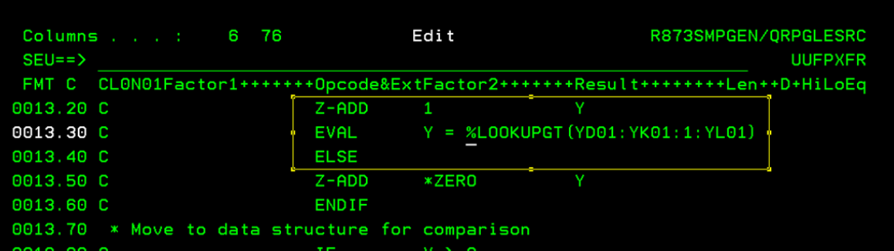
New Features in CA 2E 8.7.3
Faster Array Lookup with %LOOKUPxx – RPGIV
Notes:
Currently, the lookup in arrays within CA 2E RP4 based functions is done using the LOOKUP opcode. However, the performance of this opcode is slow. IBM has come up with the %LOOKUP built-in function which is more efficient and
faster compared to the LOOKUP opcode due to the following two critical aspects underlying %LOOKUPxx:
• A faster binary search
• Limiting the number of array elements to search for, as specified by its fourth parameter, as against an older LOOKUP
opcode that searches the entire array
Changes have been made to replace the generation of LOOKUP opcode with the more modern %LOOKUP opcode, in
functions that have the target generation language as RP4.

Slide 8
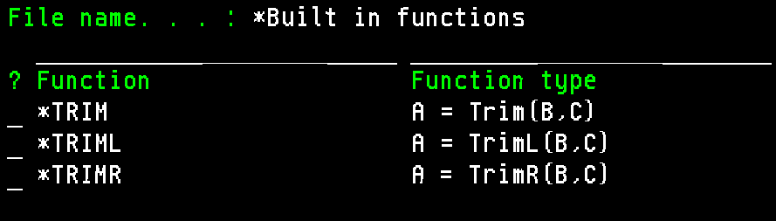
New Features in CA 2E 8.7.3
Faster Array Lookup with %LOOKUPxx – RPGIV
TRIM* String handling built-in functions – RPGIV
Notes:
New string handling built-in functions - *TRIM, *TRIML, and *TRIMR, have been added to the Action Diagram. These builtin
functions are available only for RP4 generator and will be implemented as the corresponding %TRIM, %TRIML and
%TRIMR RPGLE built-in functions. These built-in functions help to improve the developer's productivity.
These 3 built-in functions are available only for the RP4 generator.

Slide 9
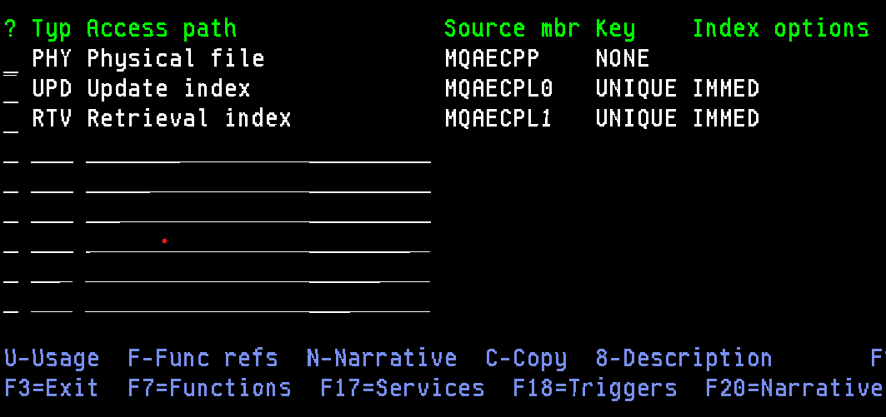
New Features in CA 2E 8.7.3
Faster Array Lookup with %LOOKUPxx – RPGIV
TRIM* String handling built-in functions – RPGIV
Copy option for 2E Access Paths on Edit File Details screen.
Notes:
Currently, there is no option to copy Access Paths within CA 2E, similar to Functions. At times, it is necessary to
create new access paths based on already existing access paths and make incremental changes on top.

Slide 10
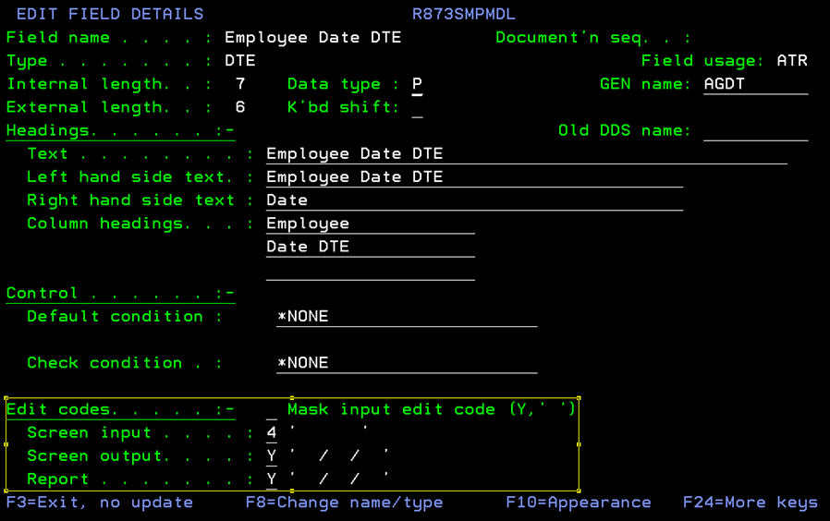
New Features in CA 2E 8.7.3
Faster Array Lookup with %LOOKUPxx – RPGIV
TRIM* String handling built-in functions – RPGIV
Copy option for 2E Access Paths on Edit File Details screen.
Allow Increased Date Range on Date Type Fields in User Screens
Notes:
Date type fields by default, is controlled by the YCUTOFF window limitation.
This limits the range to 100 years based on the YCUTOFF value as the starting value.
new functionality has been created around controlling the EDTCDE value of screen-based date fields,
depending on a new model value (YDATCDE)/new function option (EDTCDE ctrl for DATE FLDs).
These EDTCDE changes are applicable for all date-related field types such as DT#, D8#, DTE, TS#.
A new model value YDATCDE is created for this enhancement.

Slide 11
New Features in CA 2E 8.7.3
Faster Array Lookup with %LOOKUPxx – RPGIV
TRIM* String handling built-in functions – RPGIV
Copy option for 2E Access Paths on Edit File Details screen.
Allow Increased Date Range on Date Type Fields in User Screens
Generate List of Fields on a SELECT Statement Instead of "*" in Generated Code
Notes:
This feature provides the ability to select specific fields that need to be reflected on a SELECT statement upon generation,
so that, there is no need to recompile the functions in case of addition of fields to Table (where Format Level identifier is
changed).
When field level information is modified on a Table, the Format Level Identified gets modified. Any function based on this
table needs to be recompiled to prevent the Level Check error. If we select only specified fields on a SELECT statement
and those fields are not modified during the changes on Table, then there is no need to recompile the function.

Slide 12
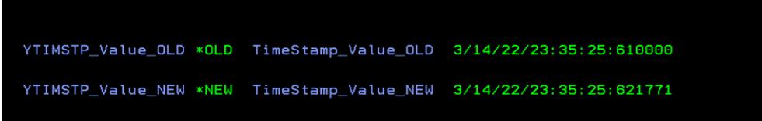
New Features in CA 2E 8.7.3
Faster Array Lookup with %LOOKUPxx – RPGIV
TRIM* String handling built-in functions – RPGIV
Copy option for 2E Access Paths on Edit File Details screen.
Allow Increased Date Range on Date Type Fields in User Screens
Generate List of Fields on a SELECT Statement Instead of "*" in Generated Code
Handle Timestamps with Increased Microsecond Precision
Notes:
Currently, the JOB.*TIMESTAMP is loaded with a value having the format "yyyy-mm-dd-hh.mm.ss.uu0000". The last four
digits are always 0’s. When applications need high precision based on timestamp microseconds, the functionality is not as
desired. As part of this enhancement, changes have been made to ensure that JOB.*TIMESTAMP is loaded with values
having the format “yyyy-mm-dd-hh.mm.ss.uuuuuu”, where all the microsecond digits are populated.

Slide 13
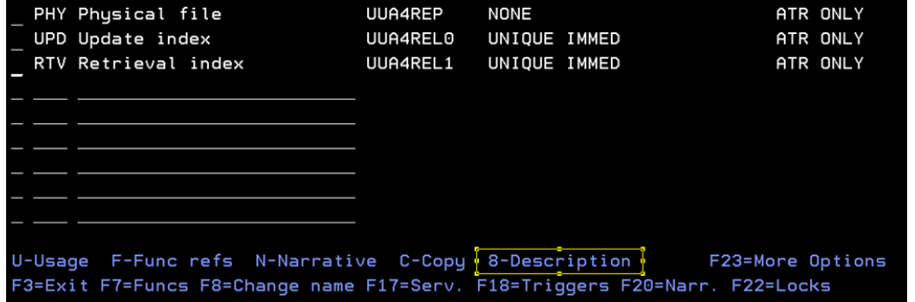
New Features in CA 2E 8.7.3
Faster Array Lookup with %LOOKUPxx – RPGIV
TRIM* String handling built-in functions – RPGIV
Copy option for 2E Access Paths on Edit File Details screen.
Allow Increased Date Range on Date Type Fields in User Screens
Generate List of Fields on a SELECT Statement Instead of "*" in Generated Code
Handle Timestamps with Increased Microsecond Precision
Reduce Memory Overrun and Provide Easier Access to Display Model Object
Notes:
As part of this enhancement, an additional option is being provided to access "Display Model Object" (YDSPMDLOD)
information, on screens related to various model object types. This helps to access the YDSPMDLOD information directly
8=Description
CA 2E - 8.7 instead of the previous two step process of "U=Usages" + "8=Details", thereby reducing unnecessary memory overrun
and improving productivity.

Slide 14
New Features in CA 2E 8.7.2
Notes:
As part of this enhancement, users can now have a better control on the change audit information and compiler directives
of function object, when object type is toggled between *PGM and *MODULE and vice versa. This helps to improve audit
tracking by tracing last change user to toggle the object type and reduce rework by saving any compiler directives prior to
toggle.

Slide 15
New Features in CA 2E 8.7.2
Enhanced Processing when toggling Object Type between PGM and MOD, using option T
  If compiler overrides exist, they are stored when toggle.
Notes:
As part of this enhancement, users can now have a better control on the change audit information and compiler directives
of function object, when object type is toggled between *PGM and *MODULE and vice versa. This helps to improve audit
tracking by tracing last change user to toggle the object type and reduce rework by saving any compiler directives prior to
toggle.

Slide 16
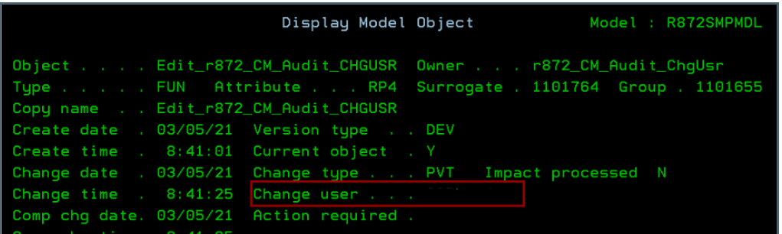
New Features in CA 2E 8.7.2
Enhanced Processing when toggling Object Type between PGM and MOD, using option T
Better audit control on YDSPMDLOD screen for reporting meaningful Change User during object promotion.
Notes:
As part of this enhancement, user now have the ability to log details of actual users changing an object other than an
Administrator on the Display Model Object Details screen while promoting objects. This helps to get more accurate
change audit information while promoting an object for easier backtracking.

Slide 17
New Features in CA 2E 8.7.2
Enhanced Processing when toggling Object Type between PGM and MOD, using option T
Better audit control on YDSPMDLOD screen for reporting meaningful Change User during object. While using CM.
Improve comment handling in source generation
Notes:
The current implementation provides the ability to control generation of comments in the function at a more granular
function level, rather than the previous model only level. This is helpful to retain comments at the model level and
suppress comments for large legacy function(s) where refactoring might not be an option and comment removal is only
way to successfully generate and compile such function(s).

Slide 18
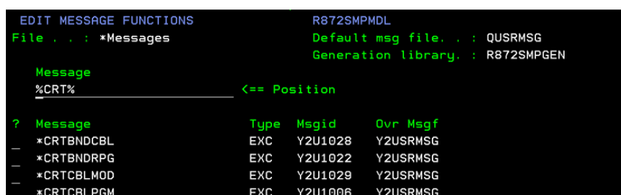
New Features in CA 2E 8.7.2
Enhanced Processing when toggling Object Type between PGM and MOD, using option T
Better audit control on YDSPMDLOD screen for reporting meaningful Change User during object
Improve comment handling in source generation
Match code search for Messages on EDIT MESSAGE FUNCTIONS screen
Notes:
As part of this enhancement, existing positioner functionality on the “EDIT MESSAGE FUNCTIONS” screen is now
enhanced to include matchcode searching, that is, the capability to select a subset of messages containing a particular
pattern specified with %’s, like %<contains_text>%, on the positioner field. This improves developer productivity
and saves time when there are lot of messages in a model and there is a need to work with subsets containing only a
particular text.

Slide 19
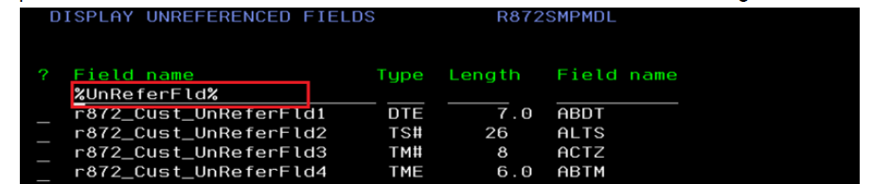
New Features in CA 2E 8.7.2
Enhanced Processing when toggling Object Type between PGM and MOD, using option T
Better audit control on YDSPMDLOD screen for reporting meaningful Change User during object
Improve comment handling in source generation
Match code search for Messages on EDIT MESSAGE FUNCTIONS screen
Positioner Field on DISPLAY UNREFERENCED FIELDS screen
Notes:
Positioner Field on DISPLAY UNREFERENCED FIELDS screen
As part of this enhancement, new positioner functionality has been introduced for the “DISPLAY UNREFERENCED
FIELDS” screen to easily position the desired field/filter for the selected field(s). This improves developer productivity and
saves time while dealing with certain field/selection of fields from a large set of unreferenced fields in a model.

Slide 20
New Features in CA 2E 8.7.2
Enhanced Processing when toggling Object Type between PGM and MOD, using option T
Better audit control on YDSPMDLOD screen for reporting meaningful Change User during object
Improve comment handling in source generation
Match code search for Messages on EDIT MESSAGE FUNCTIONS screen
Positioner Field on DISPLAY UNREFERENCED FIELDS screen
Improved Web Option Scalability by increasing maximum allowed Server Jobs and Sessions
Notes:
As part of this enhancement, the scalability of Web Option is now improved. Maximum number of Web Option server jobs
has been increased from 500 to 2000 and maximum number of Web Option sessions from 9999 to 20000.

Slide 21
New Features in CA 2E 8.7.1
Notes:
As part of this feature, user will now have the ability to conditionally generate the "OPTIMIZE for n ROWS" clause in
generated SQL.
users can now control database access based on individual file generation mode. Now, in an
external function, you can mix and match RLA and SQL access which was not feasible earlier.

Slide 22
New Features in CA 2E 8.7.1
Improved SQL Support
  OPTIMIZE for n ROWS Clause in Generated SQL
  Control Database access (RLA vs SQL) based on individual file Generation mode
Notes:
As part of this feature, user will now have the ability to conditionally generate the "OPTIMIZE for n ROWS" clause in
generated SQL.
users can now control database access based on individual file generation mode. Now, in an
external function, you can mix and match RLA and SQL access which was not feasible earlier.

Slide 23
New Features in CA 2E 8.7.1
Improved SQL Support
  OPTIMIZE for n ROWS Clause in Generated SQL
  Control Database access (RLA vs SQL) based on individual file Generation mode
Notes:
As part of this feature, user will now have the ability to conditionally generate the "OPTIMIZE for n ROWS" clause in
generated SQL.
users can now control database access based on individual file generation mode. Now, in an
external function, you can mix and match RLA and SQL access which was not feasible earlier.

Slide 24
New Features in CA 2E 8.7.1
Improved SQL Support
  OPTIMIZE for n ROWS Clause in Generated SQL
  Control Database access (RLA vs SQL) based on individual file Generation mode
Improved Web Services Support
  Meaningful Names on Web Service Interface
  RESTful Web Services
Notes:
If you are generating Webservices with 2E
As part of this feature, users can now have valid model based names on the deployed web service interface, instead of
meaningless generated names. This will help web service clients to more easily interface with CA 2E based web services.
As part of this feature, user will now be able to deploy CA 2E business logic (bound in a *SRVPGM) as a RESTful web
service.

Slide 25
New Features in CA 2E 8.7.1
Improved SQL Support
  OPTIMIZE for n ROWS Clause in Generated SQL
  Control Database access (RLA vs SQL) based on individual file Generation mode
Improved Web Services Support
  Meaningful Names on Web Service Interface
  RESTful Web Services
License Check Removal
Notes:
Changes have been carried out to remove license checks for CA 2E family of products. These changes will be applicable
after the latest CA 2E r8.7.1 is applied.
The Y2871AC and Y1871AC libraries must be present in the library lists/job
descriptions being used to prevent the license checks from happening.

Slide 26
Highlight
CA Plex

Slide 27
PTF By Number
PTFs
PTF | Bug Fixes | New Features | Certificates
006 | 20 | 0 | 3
005 | 52 | 4 | 3
004 | 0 | 5 | 0
003 | 23 | 0 | 0
002 | 38 | 0 | 0
001 | 25 | 0 | 0
GA | Many | 2 | 5

Slide 28
Highlights PTF 005
PTF 005 (PTF Note)
Navigate to previous cursor position
Type through list in Object Browser
Save Local Model Configurations
Local Model House Keeping
Product License check removal

Slide 29
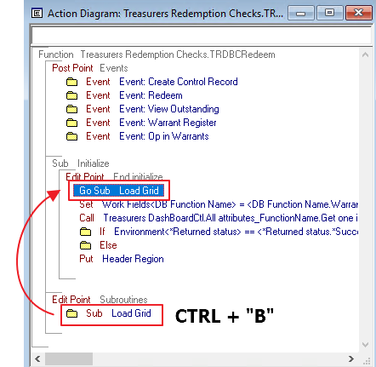
Navigate to previous cursor position
PTF 005
This functionality extends the tool’s ability to track the Action Diagram (AD) subroutine’s caller position. Once user clicks on subroutine call statement in AD, which intern jumps to subroutine definition – now user can go back to subroutine call statement using ‘CTRL+B’.
Notes:
In order to make this functionality work you can double click on the “Go Sub” statement which locate the subroutine in the AD, in case you would like to go back from where the “Go Sub” statement was you can use the shortcut “CTRL+B” or the Edit menu and the option “MoveBack to GoSub” option.

Slide 30
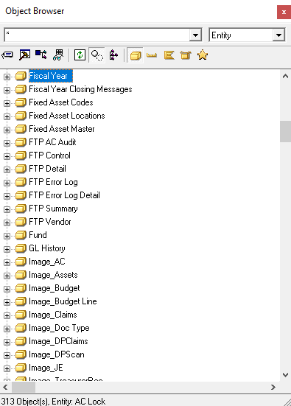
Type through list in Object Browser
PTF 005
This functionality improves the object browser searching capability by directly typing keys in object browser’s list items. Instead of locating object with single character, now quickly typed word can be searched e.g. E v/s EMP.
Notes:
In order to find a object in the object browser, you can just highlight one object in the body of the object browser and type quickly the name of the object to be found.
This functionality has been improve considering that before this, you can just find base on the first character you type.

Slide 31
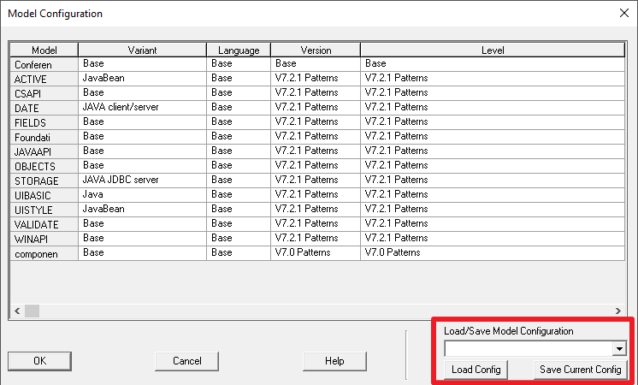
Save Local Model Configurations
PTF 005
This functionality extends the tool’s ability to save the current local model configuration and can load the saved configuration any time later.
Notes:
This feature is going to help the Plex developer when there are multiple platforms for the same Local Model.
You can have multiple model configurations for the local model.
All the configurations are saved in a List object named “ModelSavedConfig”.
This object in its large property will contains the library models reference in the group model with its appropriate configuration.

Slide 32

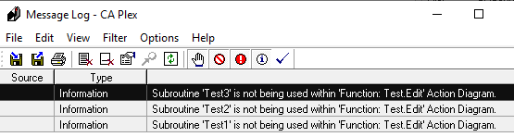
Local Model House Keeping
PTF 005
As part of this feature,
  Unused Subroutine, Fields within Action Diagram will be reported to user.
  User can opt to not generate code for unused fields in Action Diagram

Slide 33
Highlights PTF 004
PTF 004
automatically delete ‘calls FNC’ triple
select entire text in source code editor
comment & uncomment multiple selected blocks
customized search filter pattern for Object Browser
  [Object Browser]
  Object Browser Default Search Pattern=*

Slide 34
Highlights GA
7.2.1 GA
Visual Studio 2013 upgrade
Testing tool support

Slide 35
Visual Studio 2013 upgrade
7.2.1 GA
Upgrade from VS 2005 to 2013
No Backward compatibility
All C++ functions required regen and rebuild
DLL/Exe are renamed with 721 from 600

Slide 36
Visual Studio 2013 upgrade
  7.2.1 GA
Developer environment Requirements
Visual Studio 2013 Professional with Update 5
Multibyte MFC Library for Visual Studio 2013
Deployment Requirements
Visual C++ Redistributable Packages for Visual Studio 2013
https://www.microsoft.com/en-us/download/details.aspx?id=40784

Slide 37
Test Tool Friendly
7.2.1 GA
Fixed Control ID Allocation
Most UI QA automation tool requires some kind of identification to detect and memorize a specific UI control
Otherwise, it might use Label, X,Y location that are typically very weak link
Bld file setting
[Options]
Allocate Fixed Control IDs=1
WINC, Java and C# client supports

Slide 38
Certifications
CA Plex

Slide 39

Certifications
OS
Java
Windows
  Windows 10
  Windows Server 2019
  Windows Server 2022
Java
  Java 1.8
  Open JDK 8
EJB 3.x

Slide 40
Certifications
Database
.NET
SQL Server
  2014
  2019
Oracle
  19c
.Net framework 4.6

Slide 41
Windows 10
CA Plex IDE and C++ runtime
Special support Visual Studio 2013

Slide 42
.Net framework 4.6
CA Plex .NET runtime is built with 4.6
Windows 10 Default .NET Framework is 4.6.1 however, application runs
If you debug with Visual Studio 2013, requires appropriate .Net Framework targeting pack installed

Slide 43
EJB 3.x
Generated EAR file from Plex can be deployed on any application server that supports EJB 3.x
Plex EJB connector must have the following as prerequisite:
Reference implementation of EJB 3.x (GlassFish) must be available to compile the generated sources.
J2EE application server that supports EJB 3.x for deployment.
EJB Local/Remote Interface generation bld file switch
[Options]
EJB Remote Interface=0 | 1
(1: Remote, 0: Local)

Slide 44
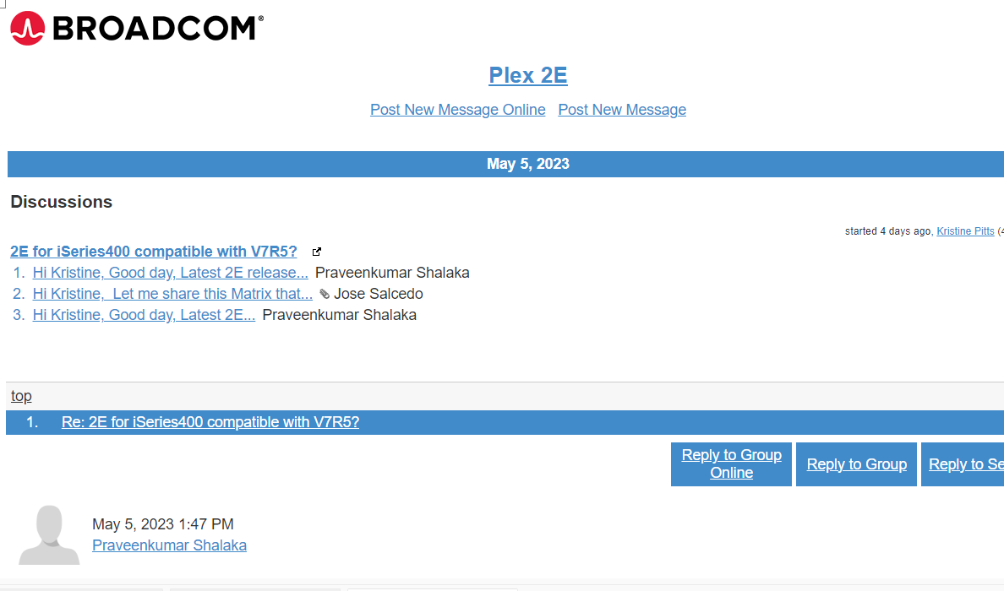
Broadcom Community Board
Broadcom 2E Plex
Daily? Email Update

Slide 45



Contact
888-866-6179
info@cmfirstgroup.com
cmfirstgroup.com

