Slide 1
Document Search

Slide 2
Welcome Message
We are searching something everyday since kids.
Or as human being since we appear on this planet.
Now a days, everyday you search on the web, also using AI to get what you are looking for…

Slide 3
Speaker
Kiyoshi Terasawa

Slide 4
Searching Data

Slide 5
Search
Definition
Verb: try to find something by looking or otherwise seeking carefully and thoroughly.
Noun: an act of searching for someone or something.

Slide 6
Search?
Pre-Computer Era
Explore
Some kind of records

Slide 7
Search?
Computer world
Use Search service
Prepare data to be searched
database
table
column (key)
Index
data
folder/file
index

Slide 8
Everyday Search
Public/Organization
Individual
Web Search
Application
Database Query
OS provided
File Search
IDE Provided
Simple match
Regex

Slide 9
AI
ChatGPT or Bing in Skype
Some level, it works as like search engine by asking certain way
However, sometimes it makes up a story, that is not true.

Slide 10
Structured vs. Unstructured
Structured data
Unstructured data
database
folder and file
text data
indexed search
AI/DL: ChatGPT
binary Data
Image recognition

Slide 11
Structured vs. Unstructured
Real world
Majority of data in real world are unstructured data, including Analog data

Slide 12
NLP (Natural Language Processing)
Not cover today but…
It exists prior computer era
It is widely used technique
Base of DL or AI
Morphological analysis
Breaking language to minimum components

Slide 13
What is this session
Simple Search
Elasticsearch
IDE
regex
Unstructured data search
High performance

Slide 14
Search
Something simple

Slide 15
Simple search
Windows Explorer
IDE
Search
by name
by size
by timestamp
Typically, slow
VS Code or Notepad++
Search in file
Search in Folders
Search with regex

Slide 16
Elasticsearch
Section

Slide 17
What is Elasticsearch?
Elasticsearch is a search engine based on the Lucene library. It provides a distributed, multitenant-capable full-text search engine with an HTTP web interface and schema-free JSON documents.
Elasticsearch is developed in Java and is dual-licensed under the source-available Server-Side Public License and the Elastic license, while other parts fall under the proprietary (source-available) Elastic License.
Official clients are available in Java, .NET (C#), PHP, Python, Ruby and many other languages.
According to the DB-Engines ranking, Elasticsearch is the most popular enterprise search engine.

Slide 18
Why uses Elasticsearch
5 key reasons
High Performance
Document-oriented Database
Schema Free
Easily Scalable
Distributed Architecture
Reference: https://veloxsoftech.com/blog/benefits-of-using-elasticsearch/

Slide 19
Why uses Elasticsearch
#1 High Performance
Elasticsearch is able to perform extremely fast searches by using distributed inverted indices. It caches all the queries for the result set, so for every search query that contains cached filter, it searches the result from the cache. Compared to typical SQL database that retrieves the searched data in more than 10 seconds, Elasticsearch can do it in less than 10 milliseconds.

Slide 20
Why uses Elasticsearch
#2 Document-oriented Database
Elasticsearch uses JSON (JavaScript Object Notation) as the serialization format for documents to store complex entities, and indexes all the records by itself. JSON serialization has become a standard format for NoSQL database, and it is compatible with various programming languages. It is very easy, concise and simple to read, which results in higher performance.

Slide 21
Why uses Elasticsearch
#3 Schema Free
Elasticsearch is schema free, which means it doesn’t require any data definition, and uses some defaults to index the date unless you specify the data type. It accepts JSON documents and detects the data type, index the records and make it searchable. When the object with a new property is indexed later, it is automatically added to the mapping definitions.

Slide 22
Why uses Elasticsearch
#4 Easily Scalable
Based on a distributed architecture, Elasticsearch can be scaled up to thousands of servers and store thousands of gigabytes of data. It is built to run smoothly on any system or in any cluster containing a number of nodes. When you grow from a small cluster to a big cluster and very big cluster, the process is nearly automatic and requires a little planning, but still painless.

Slide 23
Why uses Elasticsearch
#5 Distributed Architecture
Elasticsearch is not only perfect for handling search queries, but it is powerful enough to handle large volumes of data with its distributed architecture. The distributed approach divides the indices into shards, and shards can create innumerable replicas. As and when new documents are being added, routing and rebalancing operations are conducted automatically.

Slide 24
Why uses Elasticsearch
Summary
Can build a private search engine
With incomparable Performance

Slide 25
Elasticsearch
Demo

Slide 26
Demo

Slide 27
Demo
Find text within source code
Application/model
Result is associated main data
Re-format result for UI
Display the Result

Slide 28
Demo
Search demo : 11K files are indexed
PIC
"AC-COMPANY-REQUIRED“: “” to escape reserved character
+DCPYRGHT +DALSEL : + MUST include
+DCPYRGHT –DALSEL: - MUST exclude
de? : ? to replace a single character
SS* : * to replace zero or more characters
LAB~1 : Fuzziness ~1 means 1 character differenced

Slide 29
You may think about…
How spell check is made
How prediction is made (word level)
Meaning full prediction requires NLP, off course
Wander how the index is built?

Slide 30
Elasticsearch
steps

Slide 31
Elasticsearch
steps
Prepare data
Design schema
Index creation/update plan
Use right Query
How to show result

Slide 32
Data flow (Index creation)
Implementation
Index
Schema for ES
Record
ES_ID
Id
text
Word
[ES_IDs]
Id
path
Combine Record and Text data
Submit Index Creation

Slide 33
Steps
Prepare Index
tips
Prepare data to be searched
Define Schema
Build Index
Update Index as needed
Extract and preprocess data
Extraction PDF or paper?
Normalize: if you can, split as statements or Paragraph
Additional data for filtering

Slide 34
Define Schema
step
evolveIT
What to be searched?
How to be searched?
Extra data to search?
Associates with?
Program sources
Per line and per entire file
Source file type
Database record

Slide 35
Schema Design
Per Line
Owner info
Graph Node ID (To match result)
Asset Type name
Source type
Data for versioning
File Content
One file content as one string

Slide 36
Schema Design
Per file
Owner info
Graph Node ID (To match result)
Asset Type name
Source type
Data for versioning
Content
Line Number
Line text

Slide 37
Data flow (Search)
Implementation
Schema for ES
Index
Record
Word
[ES_Ids]
Id
path
ES_ID
Id
text
Search text send to ES engine
Look Up Index
ES record found
Your Record Id found
Search Request

Slide 38
Elasticsearch thin client
Most major languages

Slide 39
steps
Implementation
API
Obtain Elasticsearch Client
Define Schema Model
Implement Query
Transform Result
What Programing language?
Maintain Index
Define APIs
UI
Design Search UI
Invoke API
Show Result

Slide 40
Search UI
To consider
UI
Specify which index to use
define target
Search text
Option

Slide 41
Search result
For evolveIT
Result View
Search result returns hit data quickly <- Elasticsearch task
It has ID to associates with data
Get Lines hit and using owner info, can build result like tree structure
By reading data with hit owner info, you can get all lines of the owner

Slide 42
Elasticsearch
More Resources

Slide 43
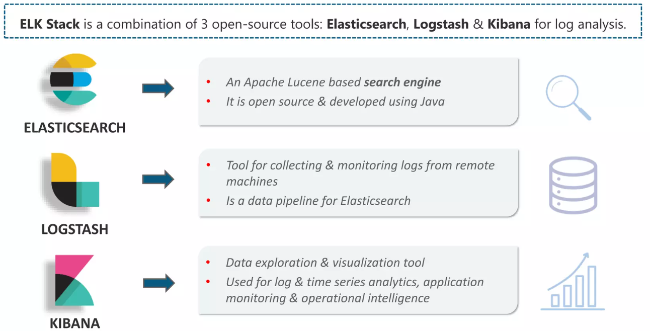
ELK Stack

Slide 44
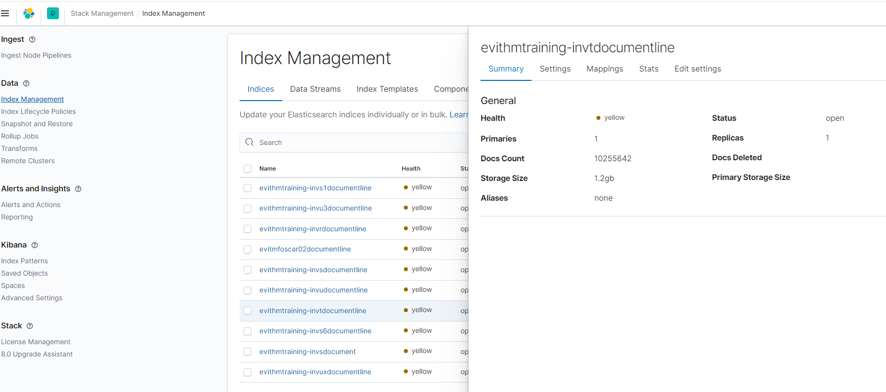
Kibana Dashboard

Slide 45
Elasticsearch
References
Elasticsearch: https://www.elastic.co/
Thin Client: https://www.elastic.co/guide/en/elasticsearch/client/index.html
APIs: https://www.elastic.co/guide/en/elasticsearch/reference/current/rest-apis.html
Kibana: https://www.elastic.co/kibana/

Slide 46
Elasticsearch
Install

Slide 47
Elasticsearch
Installation
Download Package https://www.elastic.co/guide/en/elasticsearch/reference/current/install-elasticsearch.html
MSI set up for Windows
With simple wizard, at the end of installation, it run as Windows Service

Slide 48
Install Elasticsearch
Is it running? http://localhost:9200

Slide 49
Final comments

Slide 50
Final Comments
Set up in house search is not hard as you think

Slide 51
Final Comments
Search concept is changing
Search is a kind of asking Question these days
Rule base
NLP base
How to use Search result
Off course, requires judging true/false

Slide 52
Thank you

Slide 53
Contact
+123-456-789
company@domain.com
cmfirstgroup.com

