Slide 1
CA 2E Report Modernization

Slide 2
Speakers
John Rhodes
Lily Taharudin

Slide 3
Agenda
Introduction
Objectives
JSReport architecture
JSReport deployment
Demo

Slide 4
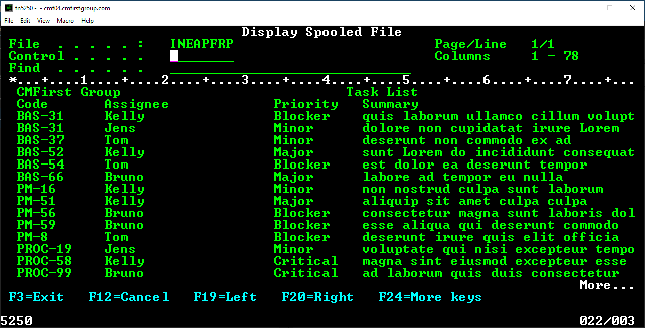
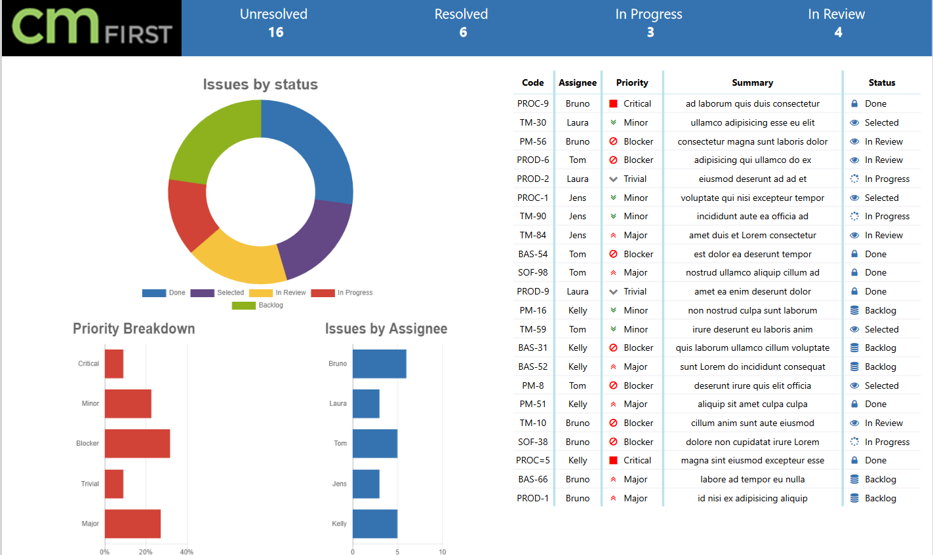
Introduction
2E Printfile
JSReport

Slide 5
Objective
Go through the process of converting 2E Print File to generating report PDF/Excel on the web application including the development, tools used, and deployment steps

Slide 6
Demo

Slide 7
JSReport
Javascript based reporting platform
Capable of producing various outputs like pdf, excel, html, docx, and csv
Open-source and cross-platform
HTML designer
APIs
Jsreport.net

Slide 8
Steps to Modernize 2E Reports
Migrate the 2E Print File/Print Object to Plex/Java
Add JSReport source code API in the Print File function
Setup development workspace using Eclipse
Create ReportControl.json
Create PDF/Excel template
Install JSReport server
Create Javascript files to customize the report content
Create CSS file for report look/feel

Slide 9
Migrate 2E Print File to Plex/Java
Use existing 2E model and transform the model into Plex

Slide 10
JSReport Source Code API
JSReport Service Initialization
AddReportData
Generate report

Slide 11
Setup Development Workspace
Create a Java project for print file function generated in Java, report source files, M3Report.jar and dependencies
Import CM WebClient project
Create a web project for web resources

Slide 12
application.properties
JsReportServiceURL
A required property field to the JSReport server deployed URL
JsReportServiceUser
A required property field for JSReport server username
JsReportServicePassword
A required property field for JSReport server password
DebugOutFolder
An optional property field for ReportControl.json debug output directory
OutputPath
An optional property field for generated report field output directory

Slide 13
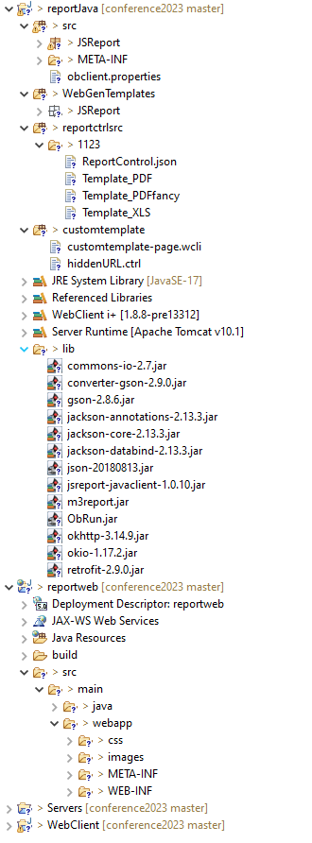
Workspace Project Structure
Workspace Project Structure

Slide 14
Create ReportControl.json
Contains the properties used to control the report output
Used tool to extract the print file information
Properties including
page size of the report
field display attributes
data format

Slide 15
Create PDF/Excel Templates
Generate PDF/Excel templates for each of the print file and print object functions
Based on HTML syntax
Use handlebars templating engine

Slide 16
PDF Template

Slide 17
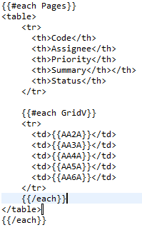
Excel Template

Slide 18
JSReport Server
Set up
Download and Install: https://jsreport.net/on-prem
Node.js >= 16.11 is required
Self-hosting server
Licensing https://jsreport.net/buy
Free version allows only 5 files to be uploaded so requires paid version
Report resources for JS Report Server
Auto upload is available as console java
All files are uploaded to root of the server
List of files
CSS
Javascript
Templates for PRTOBJ

Slide 19
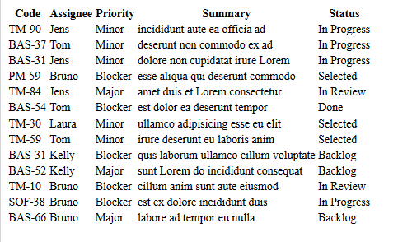
Transformation
Out of the box
Fancy

Slide 20
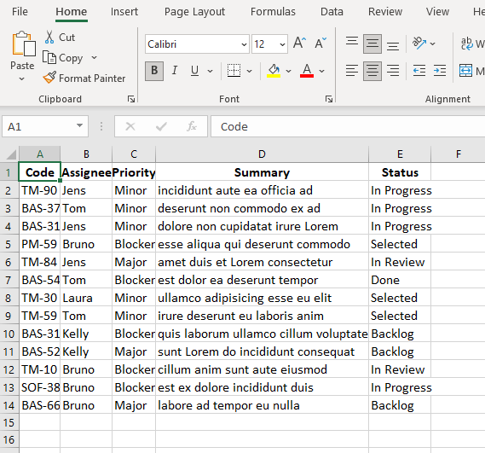
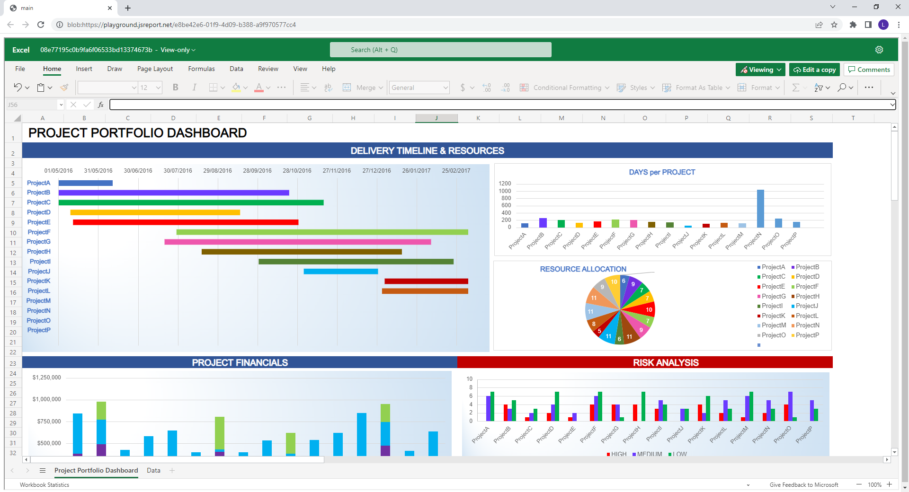
Transformation

Slide 21
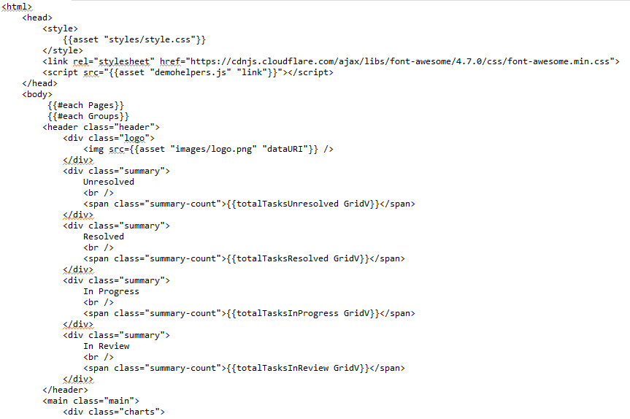
CSS

Slide 22
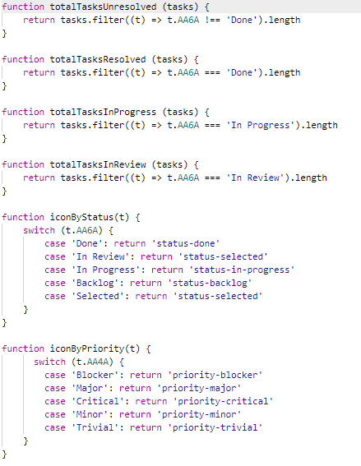
Javascript

Slide 23
JSReport Deployment Architecture

Slide 24
Runtime Flow
JS Report Server
Web Client
css
Javascript
PRTOBJ templates
M3 Report Runtime
http Generate Request
Template
Report Data
Initialize
Dump Data
Generate Report
Report Service
PRTFIL
PRTOBJ
Template
Report data
PDF/Excel
PDF/Excel
Load
Control.json
template
DB

Slide 25
Runtime Flow
Any Function or even Menu calls PRTFNC function
Initialize Report Service, loading Report Control file and Template locally
The function execution, Read data, call another function etc.
Print statement invokes Report Service
Report Service accumulate data to View Model
At the end of Function, request generate report
Report Service invoke JS report API with template and report data
JS Report generate report using given data + css + js + prtobj templates as needed
JS Report output report in server as well as stream back to caller
Back to Report Service
Back to Function

Slide 26
Deployment
Installed JSReport server
Upload report assets – CSS, Javascript, images, Print Object templates
Deployed war file to web server
Setup application.properties file

Slide 27
Questions

Slide 28
Contact
john.rhodes@cmfirstgroup.com
lily.taharudin@cmfirstgroup.com
www.cmfirstgroup.com

