Slide 1
SQL Performance Tuning
Better SQL with Plex

Slide 2
Speaker
Abram Darnutzer
Senior Consultant - CMFirst

Slide 3
Plex Generated SQL
What works
Easy to create
Get something up and running in a few minutes
Reasonably customizable

Slide 4
Plex Generated SQL
Shortcomings
Static Where Clauses
No complex joins
Limited SQL Terms
No Select Top N
No Count
Etc.

Slide 5
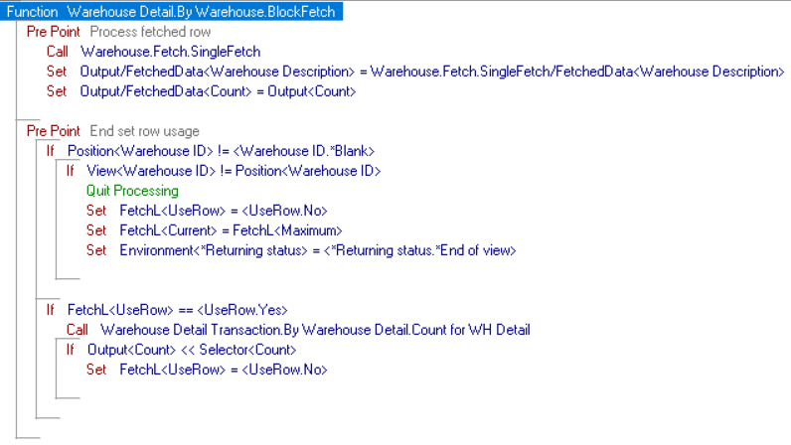
Consequences
Because of this, we end up with code that takes minutes and seconds to run instead of milliseconds
Example

Slide 6
Stage 1: Denial
"But Abram, I'll show you! I'll make Indexes! Indexes as far as the eye can see!" - someone in the audience (probably)
Well.......that can help. But there are many situations where Indexes will not help in any way.
For example, anything to do with Counts. Especially, filtering based on those counts.
Another example: Filtering on fields not included in the Index.

Slide 7
So, what do I do now!?
Create your own SQL
The "Select Where" statement can be a great benefit when you are querying a single table and have dynamic filter options. It is certainly much better than using a wrapper function that calls many different BlockFetch functions.
But for anything where you are pulling from more than 1 table or needing to use any SQL terms not generated by Plex, you will want to use "Exec SQL"

Slide 8
Exec SQL
Easiest way to start is by building you own pattern
"Exec SQL" works over a specific Variable in the function and is performed with a Source Code object.
After the "Exec SQL" is run, then perform a FetchNext on that same Variable
Please note that the order of the fields in your variable will dictate what part of the select statement uses them.
Meaning "select F1, F2 From Table" will put the value of F1 in the first field in the variable and F2 in the second field in the variable.

Slide 9
Exec SQL Quirks
It wouldn't be Plex without quirks
If you're where clause in your Source Code object looks like this "Where CompID = '&(1:)'", then there is no additional triples needed.
But if your where clause is completely dynamic like this "WHERE &(1:)", then you need to add a "SQL Statement Type Unprepared" triple to your source code object.
If you use the Unprepared setup, then any static objects in your query will need to be surrounded by double single quotes. (Don't ask me why).
Example: FROM WHDETAILP T1 JOIN WHP T2 ON T1.CompID = ''test''

Slide 10
How do I know what SQL to write?
Use the Plex Generated SQL as a guide
In a notepad, build the SQL you want to run.
Manually test the SQL
Convert it into Plex objects

Slide 11
Results
Original
Rewrite
5-6 seconds for the initial load
5-6 seconds for filtering on a warehouse
1071510570234750284690 seconds on filtering on the Count
< 1 second for initial load
< 1 second for filtering on a warehouse
< 1 second on filtering on the Count

Slide 12
Audience Participation
Please say in unison
"Wow Abram! This was very informative and maybe the greatest presentation in the history of mankind. But can you give me one more real-world example where Plex SQL would give me problems?"

Slide 13
I'm glad you asked
Large data sets can cause issues even if you only are processing a single record from that set.
NextSurrogate is a common culprit here that can cause massive data issues.
Let's see how to fix this.

Slide 14
Conclusion
Constructing your SQL using these methods will always return better performance results.
But don't feel like you need to do this everywhere. Find problem areas: Complete Grid Loads, Large tables, etc.
Focus on those first.

Slide 15
Contact
Abram.darnutzer@cmfirstgroup.com
www.cmfirstgroup.com

