Slide 1
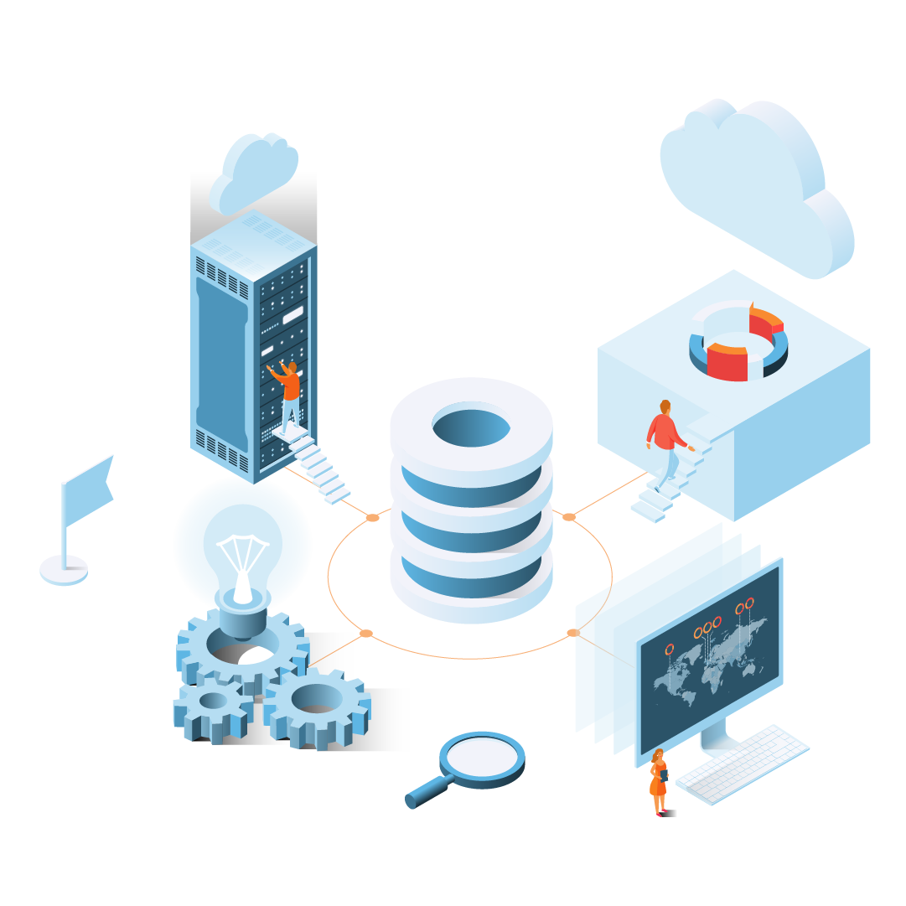

Abacus Solutions
Chris Carlson
Senior Account Executive
(770) 738-1132
chris.carlson@abacussolutions.com
www.abacusllc.com

Slide 2
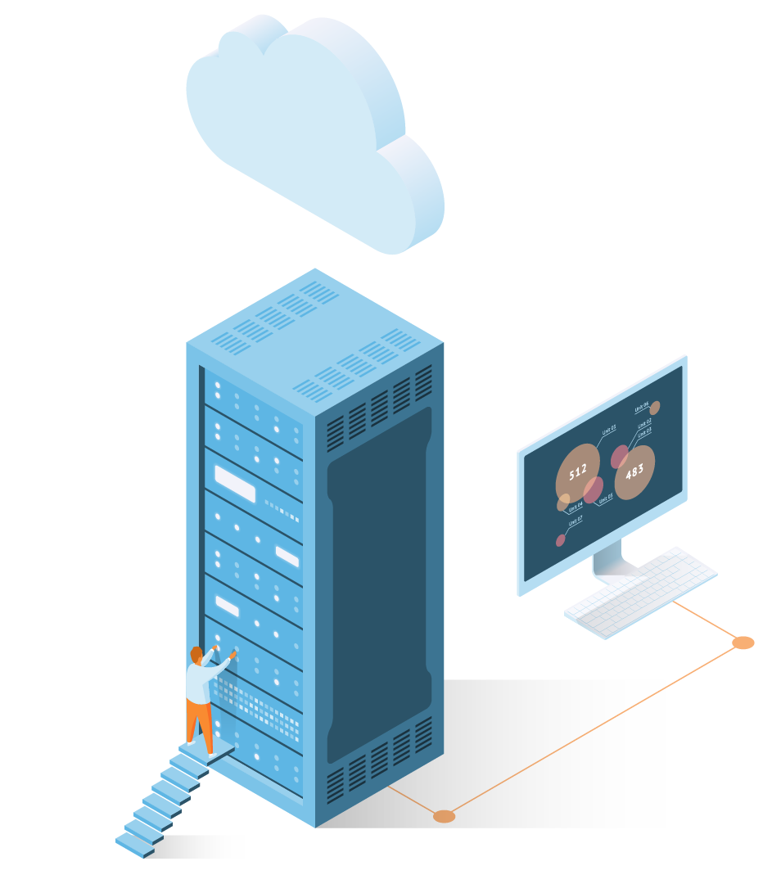

Who we are
Abacus is an AS/400-focused platform provider offering cloud, managed services, and IBM products.
The platform goes by many names – AS/400, IBM Power Systems, System i, or IBM iSeries – and Abacus can do anything and everything up to the application level.
Our goal is to run the last 10,000 IBM i environments with, and for, our customers.

Slide 3
What we do
Jump into the deep end of AS/400 cloud or transition your premise infrastructure over time. Abacus has a flexible portfolio of cloud, premise, and even hybrid solutions that help you to move to the cloud when you’re ready.
HYBRID
CLOUD
PREMISE
Our goal is to run the last 10,000 IBM i environments with, and for, our customers.

Slide 4
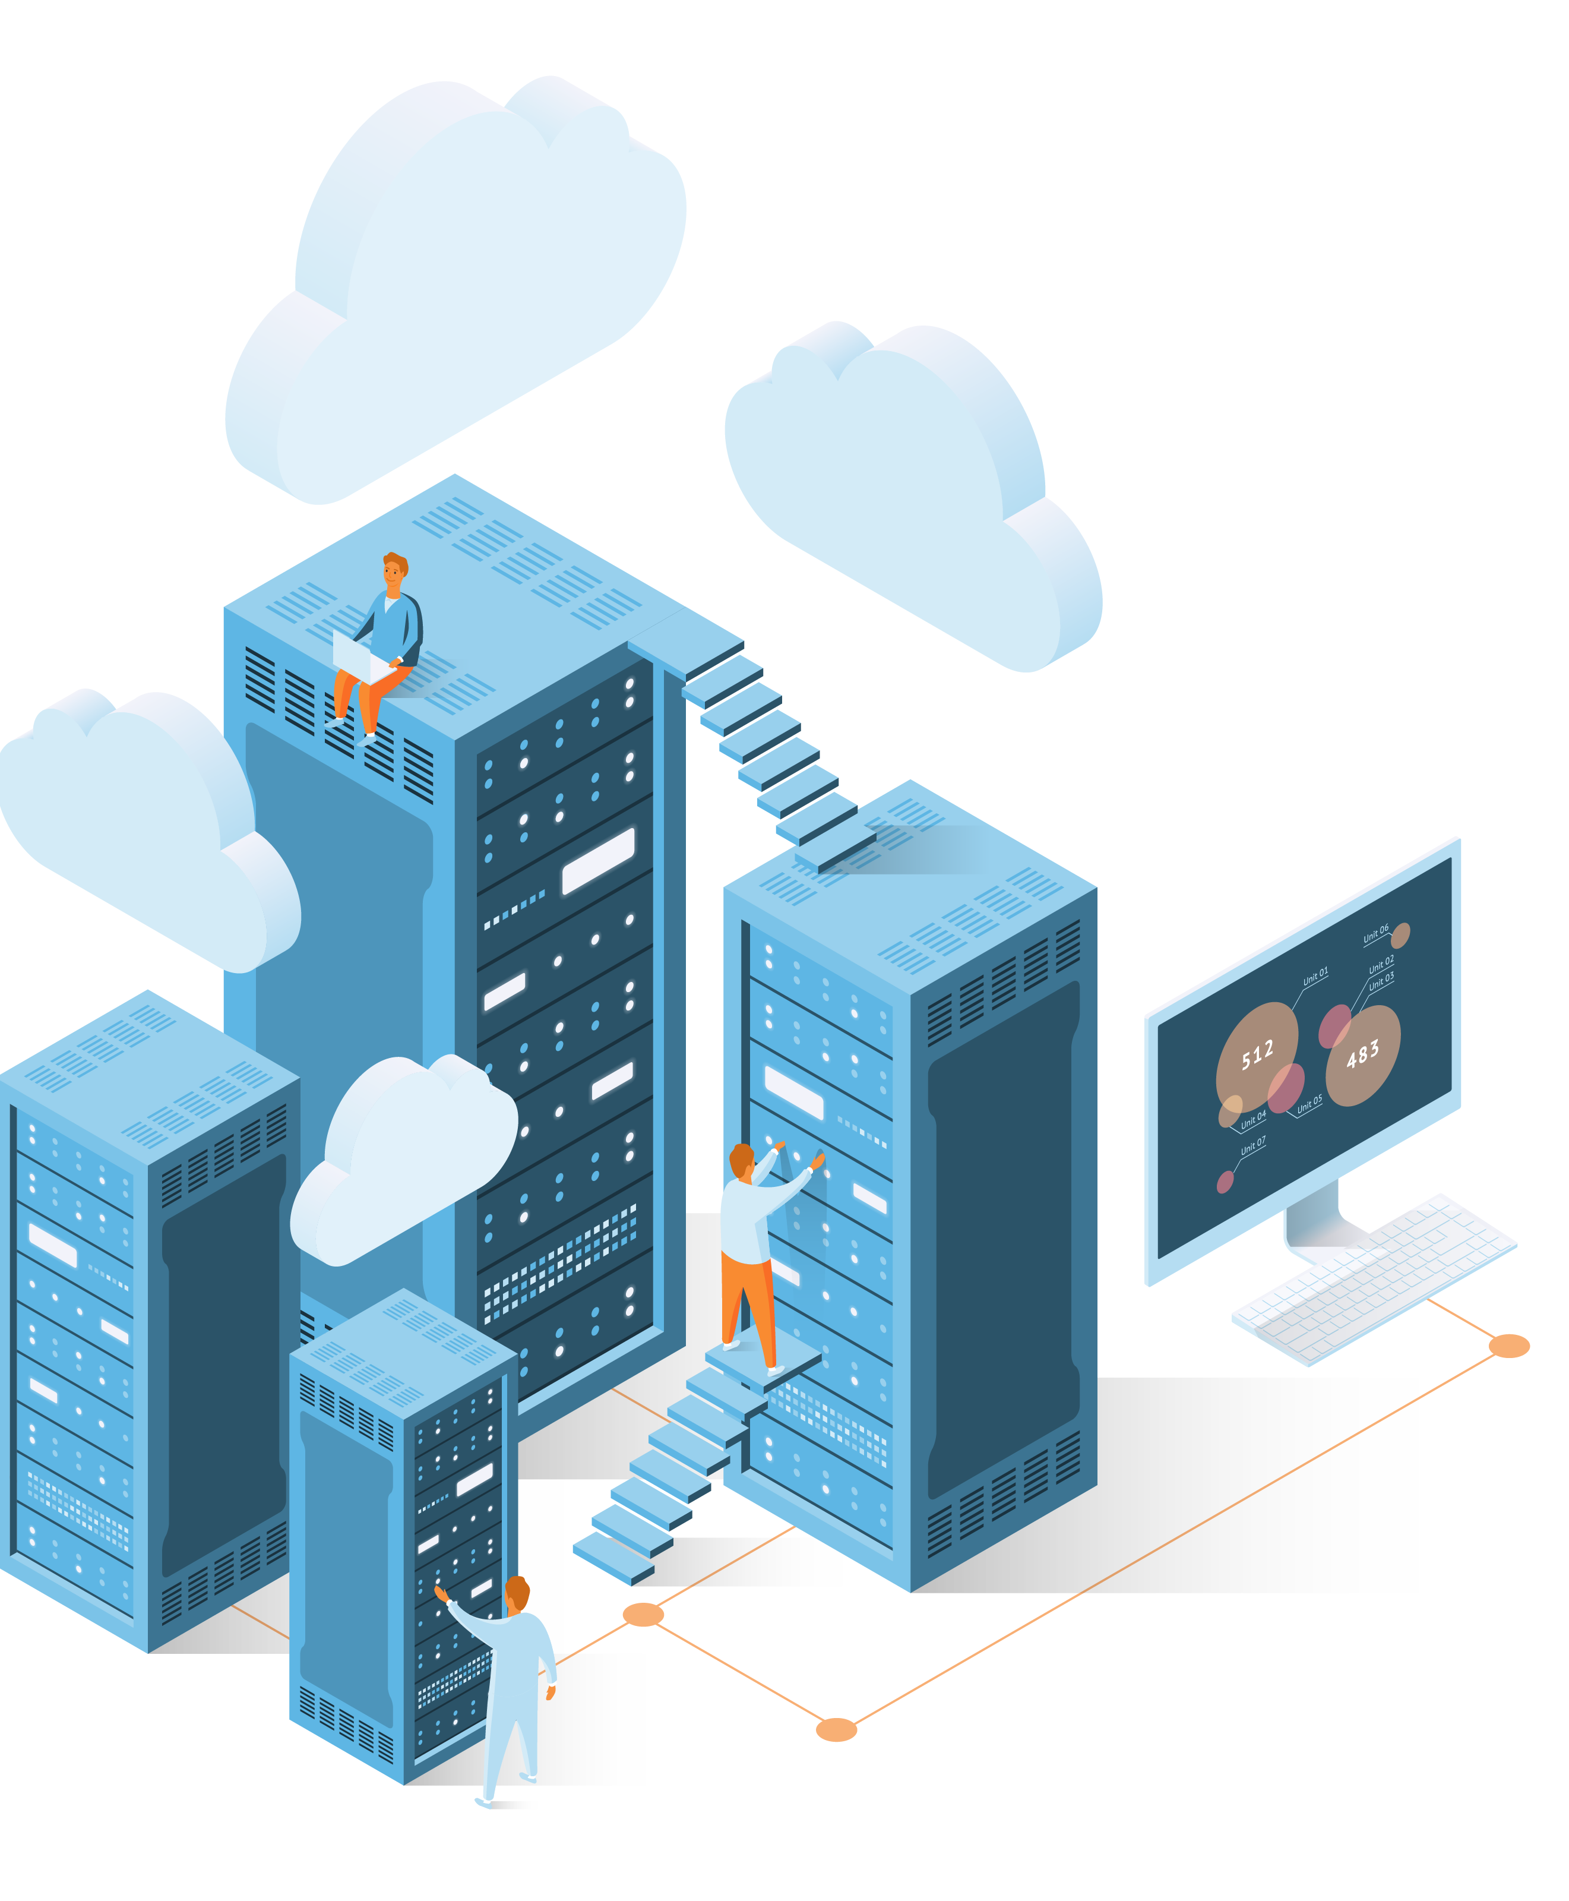
Cloud Solutions
Enterprise i Cloud
Entry i Cloud
Cloud Hosting
High Availability as a Service
Backup as a Service
Disaster Recovery as a Service (Start Recovery <12 Hours)
Disaster Recovery as a Service (Start Recovery <24 Hours)
Windows Cloud
OS Upgrade Test Flight
Our goal is to run the last 10,000 IBM i environments with, and for, our customers.

Slide 5
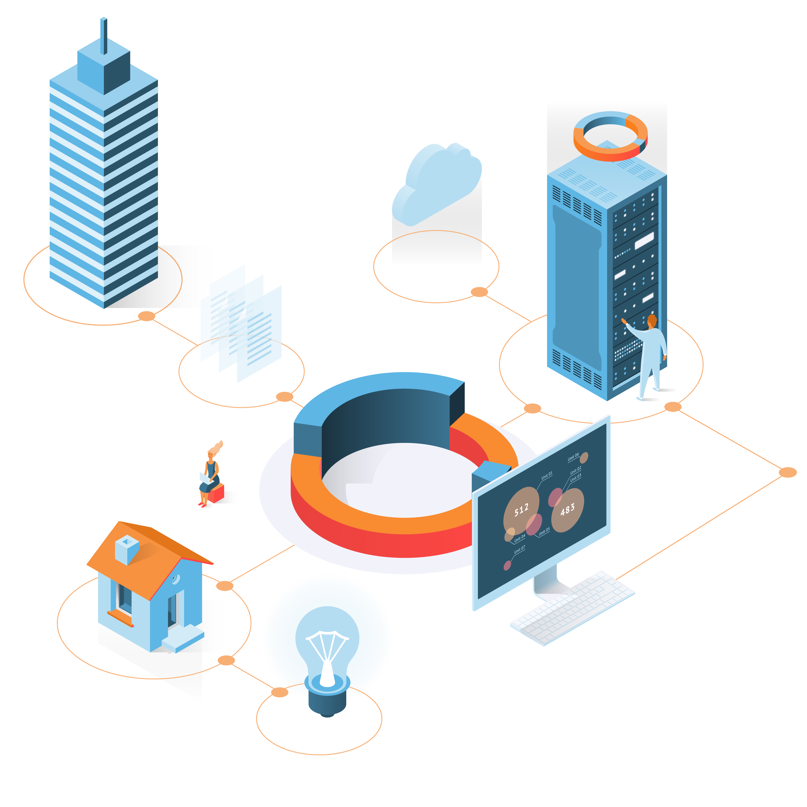
Managed Services
Backup Management
Operations Management
High Availability Management
Disaster Recovery Management
Maintenance Services
Technology Services
Performance Assessment
Health Check
Our goal is to run the last 10,000 IBM i environments with, and for, our customers.

Slide 6
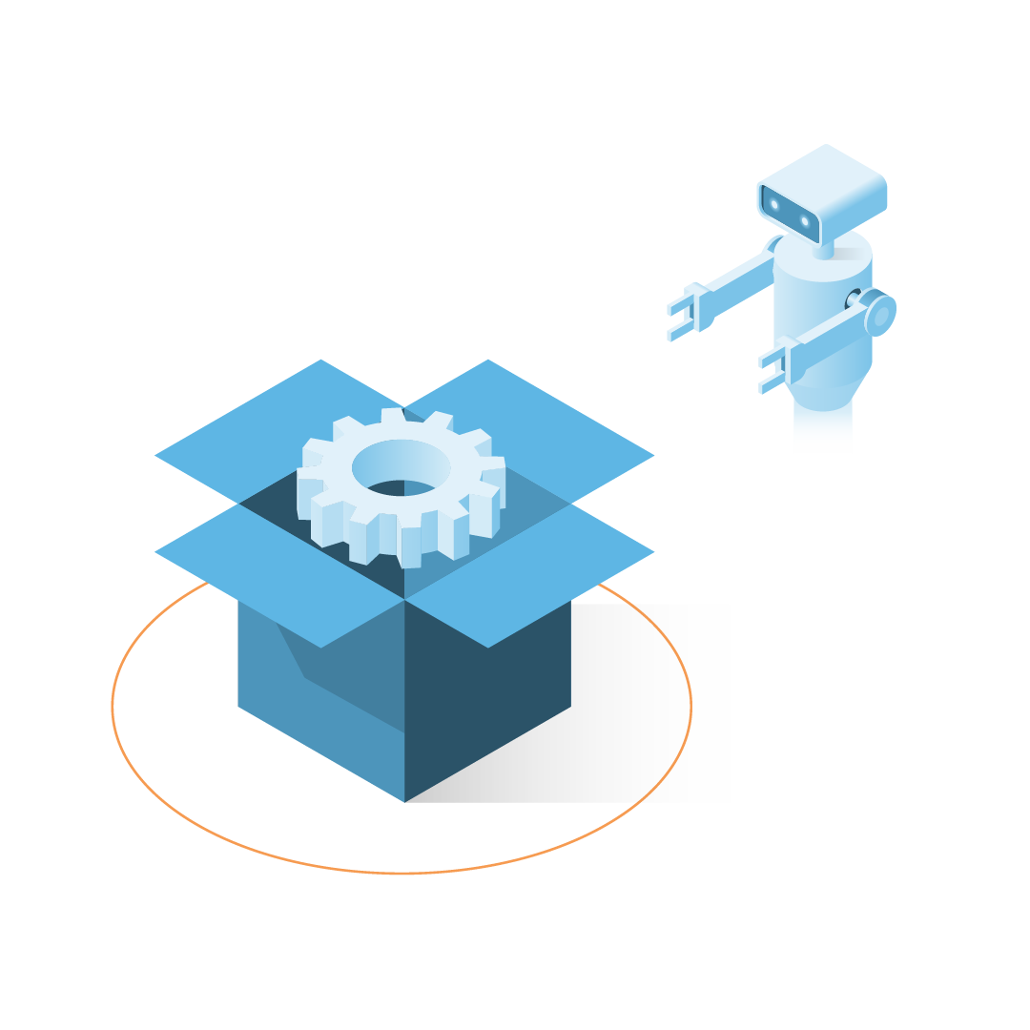
Product
New Hardware
Pre-Owned Hardware
Additionally, Abacus Solutions is an IBM Gold Business Partner
Our goal is to run the last 10,000 IBM i environments with, and for, our customers.

Slide 7

Our resources
Technical Team: We have 30+ of the best AS/400-skilled technical, sales, and support talent in the industry
Data Centers: QTS – Metro, QTS – Irving, and 1190 Kennestone Circle
Compliance: SOC2 Type 1, SOC2 Type 2, ISO27001, GDPR alignment.
Support: ITIL focused Network Operations Center, customer information portal, and support center ticketing system
Lab: audit, testing, solution builds, development, proof-of-concept,
cloud, services, shipping/receiving, and logistics
Our goal is to run the last 10,000 IBM i environments with, and for, our customers.

Slide 8
Abacus IBM i PaaS Responsibility Matrix
Service | Premise (Traditional) | Premise (MSP) | Hybrid |  | Cloud
Applications | Customer | Customer | Customer |  | Customer
Ops Management - High | Customer | Customer | Customer |  | Customer
Network Connectivity | Customer | Customer | Customer | Abacus | Customer | Abacus
Ops Management – Med/Low | Customer | Abacus | Abacus |  | Abacus
Backups (Local) | Customer | Abacus | Abacus |  | Abacus
Hardware | Customer | Abacus | Abacus |  | Abacus
Data Center | Customer | Customer | Customer | Abacus | Abacus
Our goal is to run the last 10,000 IBM i environments with, and for, our customers.

Slide 9




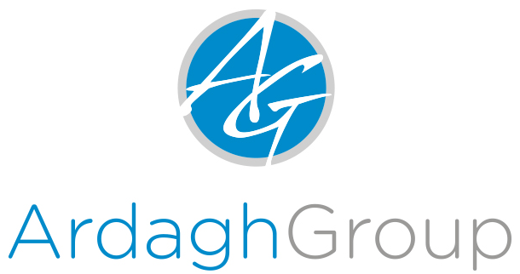
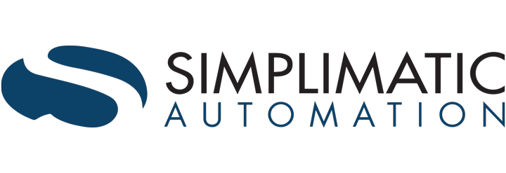



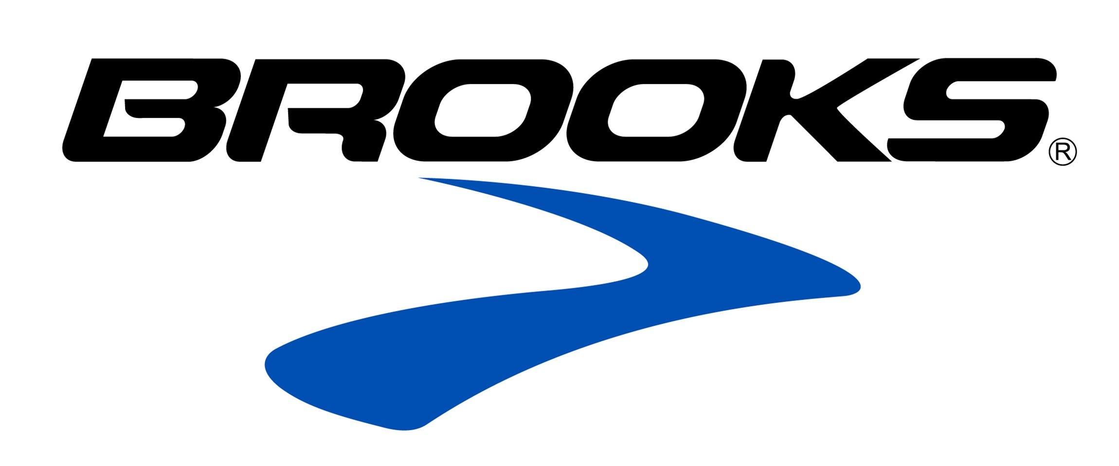
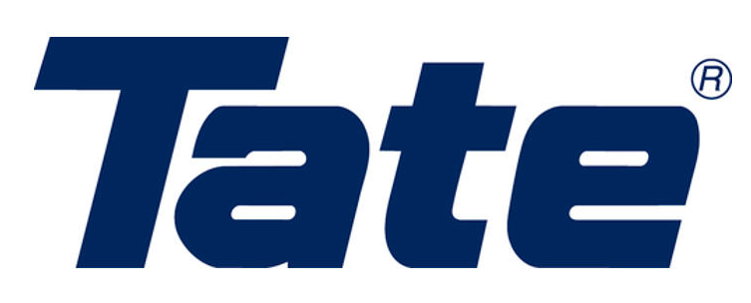
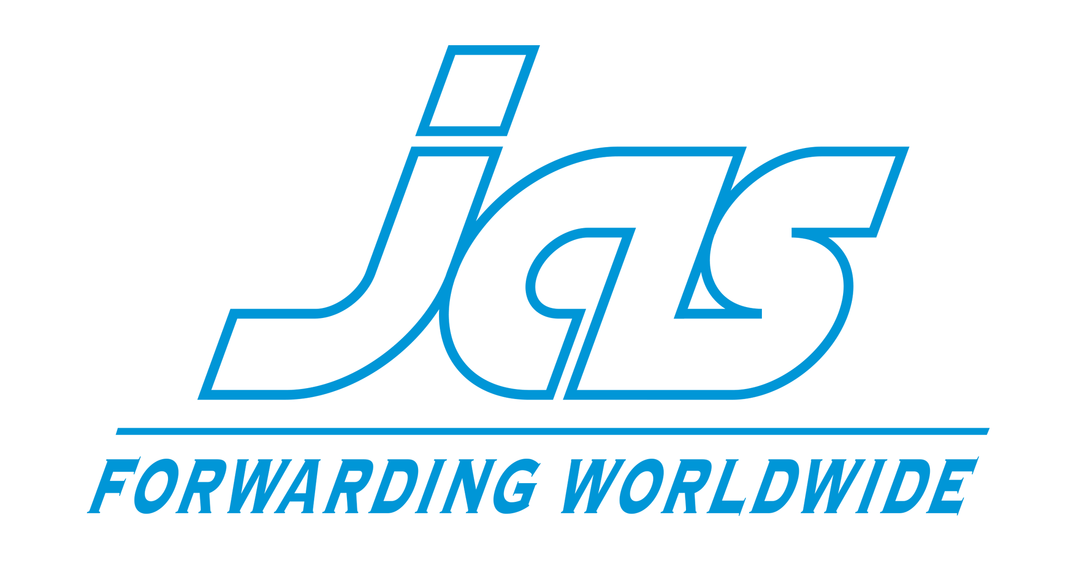



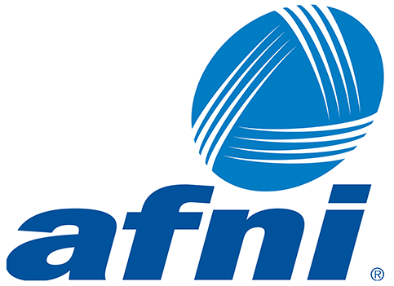






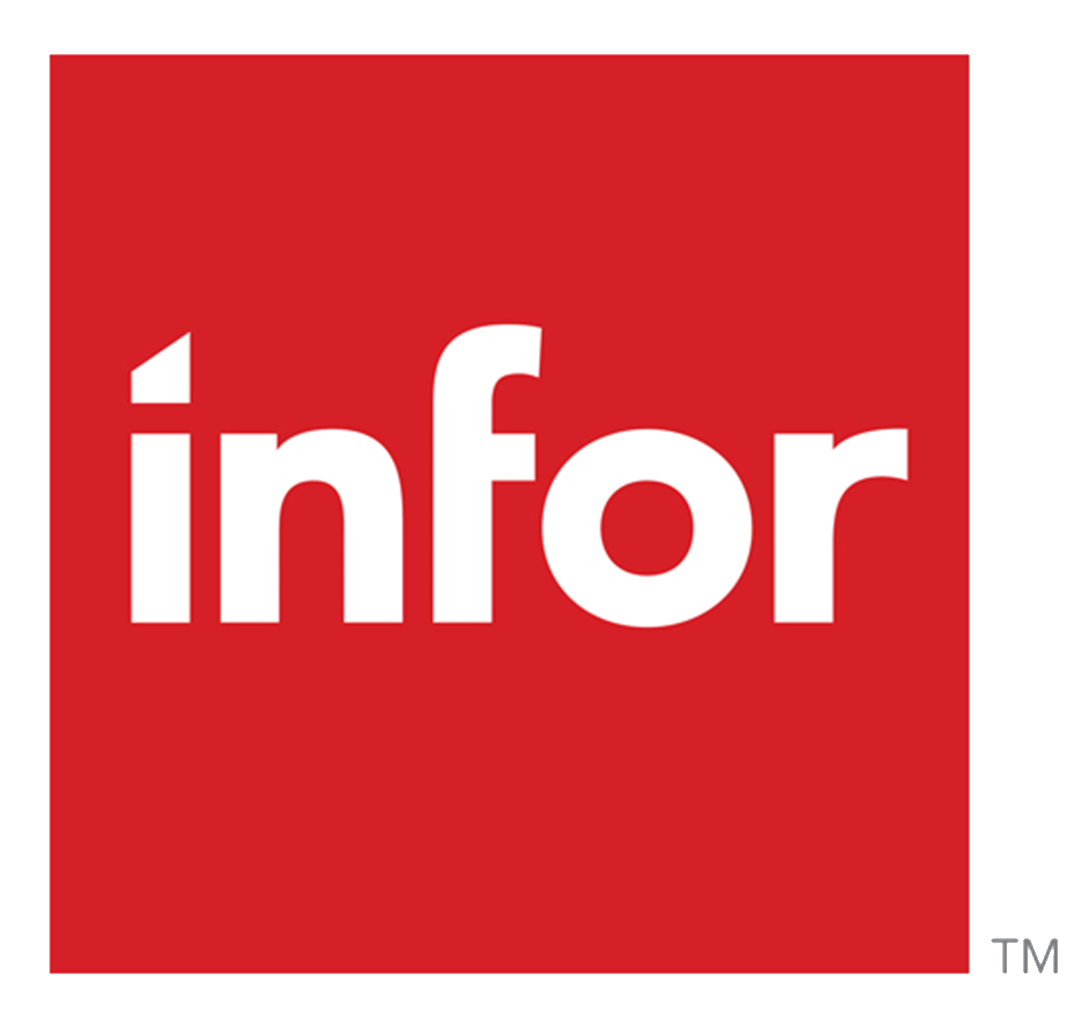

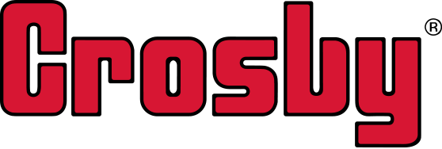




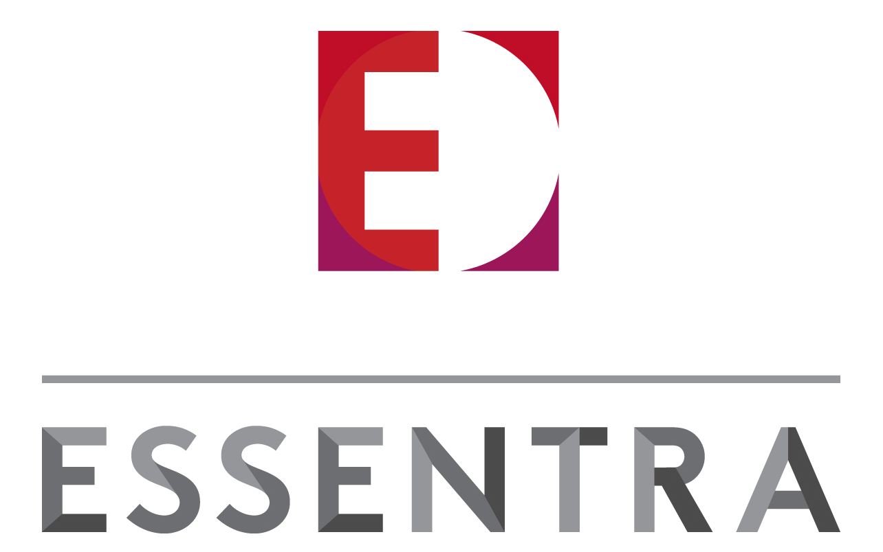
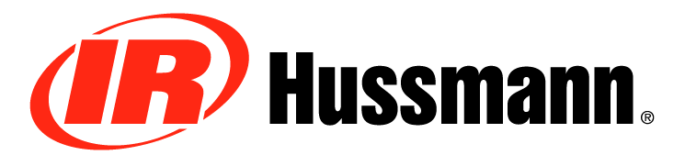




Some of our customers
Our goal is to run the last 10,000 IBM i environments with, and for, our customers.

Slide 10
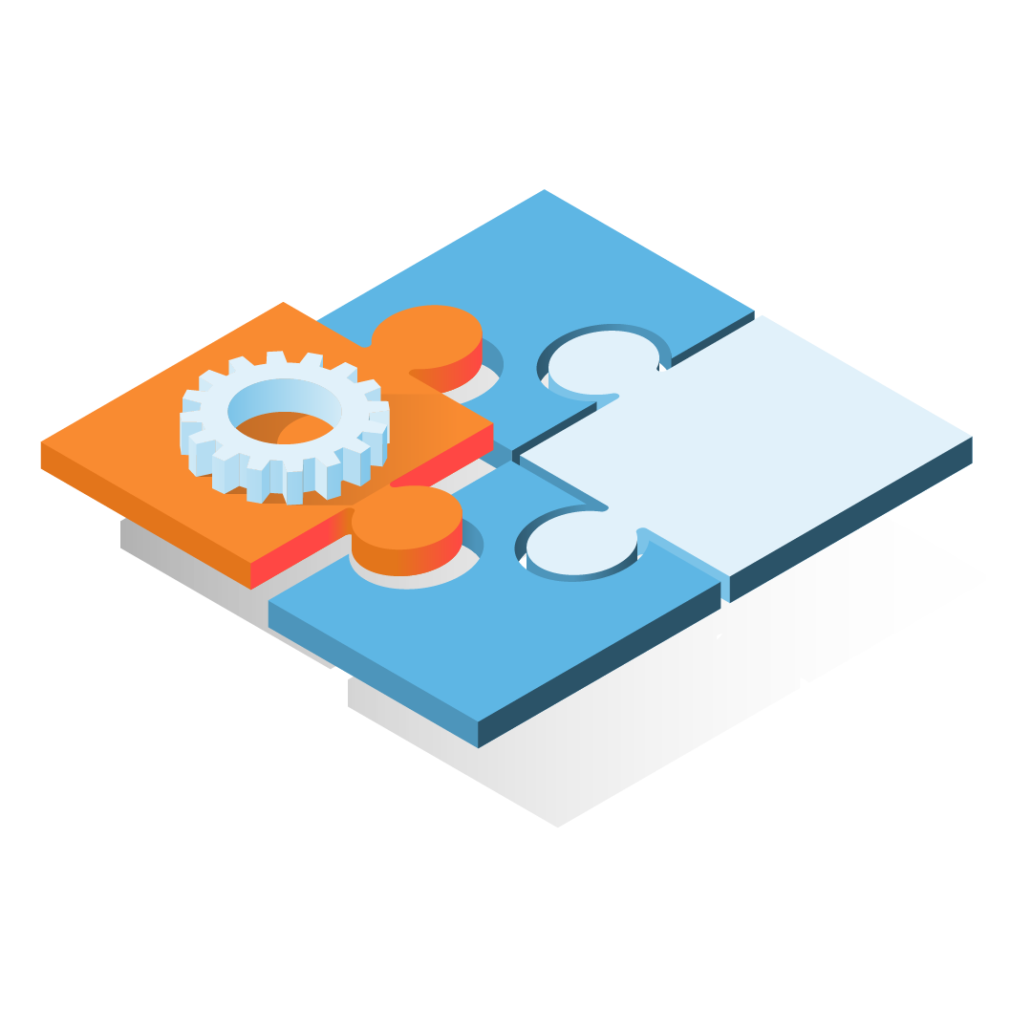
Chris Carlson
Senior Account Executive
(770) 738-1132
chris.carlson@abacussolutions.com
www.abacusllc.com
Our goal is to run the last 10,000 IBM i environments with, and for, our customers.

